Slide 1
Ulwazi ngokwabelana ngeSondo ngoMngxuma welindle

Slide 2
Kukuthini ukwabelana ngesondo ngomngxuma welindle?
Ukwabelana ngesondo ngomngxuma welindle kuxa indoda ifaka incanca kumngxuma weqabane layo okanye kundonci.
Notes:
Oku akufani naxa incanca ufakwa ekukwini "ngasemva".

Slide 3
Ngubani owabelana ngesondo ngomngxuma welindle?
Nangona abantu abaninzi beneentloni ngokuthetha ngako, zonke iindidi zabantu babelana ngesondo ngomngxuma welindle.

Slide 4
Amadoda nabasetyhini babelana ngesondo ngomgxuma welindle, nokokuba unomdla wokwabelana ngesondo nesiphi na isini.
Ngubani owabelana ngesondo ngomngxuma welindle?

Slide 5
Kutheni abantu bangabelana ngesondo ngomngxuma welindle nje?

Slide 6
Zininzi izizathu ezibangela ukuba abantu babelane ngesondo ngomngxuma welindle,
ezinye zibandakanya:
ukufun’ukwazi
ulonwabo
isithukuthezi
ukufuna ukuchama ngokukhawuleza
ukuva okuqinileyo
ukwanelisa iqabane
imali
ngexesha lokukhulelwa okanye lokuya exesheni
njengendlela yokuthintela ukumitha
ukugcina ukuhlala ‘uyintombi nto’
ukwandisa ukuthandana
nezinye izizathu ezininzi

Slide 7
Ingaba i-HIV ingagqithiswa ngokwabelana ngesondo ngomngxuma welindle?
Ewe.
Enyanisweni, ukwabelana ngesondo ngomngxuma welindle okungakhuselekanga kubeka abantu emngciphekweni omkhulu wokufumana i-HIV ngaphezu kwayo nayiphi na indlela yokuziphatha yowabelana ngesondo.
Ukwabelana ngesondo ngomngxuma welindle okungakhuselanga ngumngcipheko omkhulu kwabasetyhini kunokwabelana ngesondo ekukwini kungakhuselekanga xa kuthethwa ngokufumana i-HIV nezinye ii-STI.

Slide 8
Kutheni ukwabelana ngesondo ngomngxuma welindle kungumngcipheko omkhulu?
I-HIV ingagqithiswa ngokulula ngokwabelana ngesondo ngomngxuma welindle kuba ithishyu ekundonci i- thambile kwaye ayinalo uthambiso lwendalo.
Ithishyu kandonci yonakala ngokulula xa kusabelwana ngesondo ngomngxuma ongathanjiswanga, nto leyo ethi ivulele ithuba elilula lokungena kwentsholongwane ye-HIV emzimbeni.

Slide 9
Ndingazikhusela njani kwi-HIV ngexesha lokwabelana ngesondo ngomngxuma welindle?

Slide 10
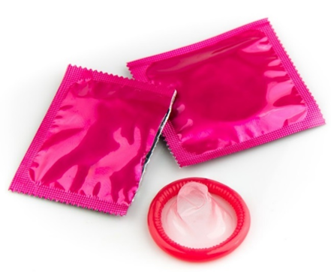
Ndingazikhusela njani kwi-HIV ngexesha lokwabelana ngesondo ngomngxuma welindle?
Eyona ndlela ingcono kukuzikhusela kwi-HIV ngeli xesha usabelana ngesondo ngomngxuma welindle kukusebenzisa iikhondom nezithambiso ezinamanzi (njenge-KY jelly).
Izithambiso ezine-oli (njenge-Vaseline okanye into yokuthambisa umzimba) zingazonakalisa iikhondom kwaye akufuneki zisetyenziswe.
Notes:
Ezinye iindlela ezinciphisa umngcipheko zibandakanya ukunciphisa inani lamaqanabe owabelana nabo ngesondo nokusebenzisa ezinye iindlela zokwabelana ngesondo ezinomngcipheko omncinci endaweni yokwabelana ngesondo ngomngxuma welindle.

Slide 11
Ayaziwa ukuba ukusebenzisa i-dapivirine ring ekukwini inika ukhuseleko na kwi-HIV xa nisabelana ngesondo ngomngxuma welindle. Ingaze iringi ifakwe ngondonci.
Ndingazikhusela njani kwi-HIV ngexesha lokwabelana ngesondo ngomngxuma welindle?

Slide 12
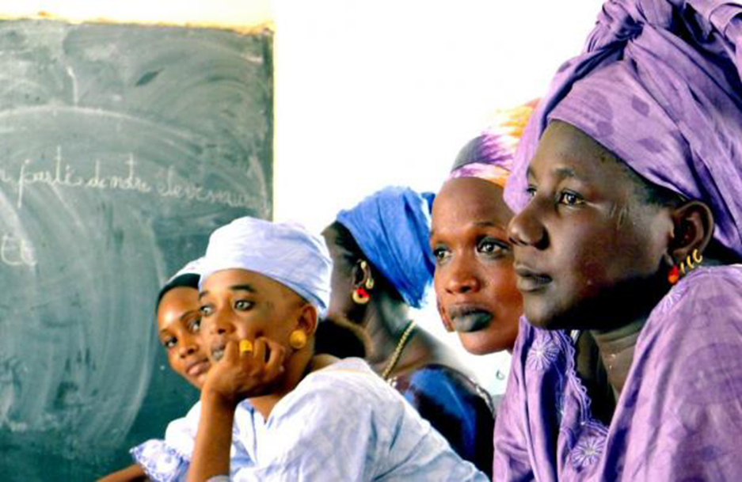
Kutheni kubalulekile ukuthetha ngokwabelana ngesondo ngomngxuma welindle kwi-HOPE?

Slide 13
Kutheni kubalulekile ukuthetha ngokwabelana ngesondo ngomngxuma welindle kwi-HOPE?
Abasetyhini namadoda amaninzi awayazi ukuba ukwabelana ngesondo ngomngxuma welindle kubabeka kumngcipheko omkhulu we-HIV nezinye ii-STI.
Notes:
Abasebenzi bophando bacela ukuba sithethe ngokukhululekileyo ngeendlela zokwabelana ngesondo ngomngxuma welindle ukuze siqiniseke ukuba abathathi nxaxheba banolwazi abaludingayo ukuze bazikhusele.
Iringi yayingenzelwanga ukukhusela ukugqithiswa kwe-HIV ngokwabelana ngesondo ngomngxuma welindle kwaye akufanelanga ukuba isetyenziswe kundonci.
Ukuba umthathi-nxaxheba ufumana i-HIV ngexesha lophando, ulwazi ngeendlela zokwabelana ngesondo ngomngxuma welindle luza kunceda iqela labaphandi baqonde ukuba usulelelo beluzakugqithiswa ngenxa yeendlela zokwabelana ngesondo ezingakhuselwanga ngokusebenzisa iringi efakwa ekukwini.

Slide 14
Abasebenzi bophando bakhona ukuze bakuncede
Abasebenzi bophando bayafumaneka ukuze bazise baze bacebise abathathi-nxaxheba bophando, amaqabane abo, namanye amalungu okuhlala ngokwabelana ngesondo ngomngxuma welindle nangayo nayiphi na imibuzo okanye iinkxalabo abanganazo kwaye bazakwenza oko bengabagwebi nangendlela abayiqeqeshelweyo.

Slide 15
Ukuba unemibuzo okanye ufuna ulwazi oluthe vetshe, nceda undwendwele ikliniki yophando

